Slide 1
LTPP Datasets
Data Engineering
Parameter Fine-tuning
Train dataset
Test dataset
LSTM-MA
RNN
Testing
FNN
LR
SVR
XGB
RF

Slide 2
LTPP Datasets
Data Engineering& preprocessing
Fine-tuning
LSTM+MA
Test
dataset
LR
SVR
Train
dataset
Train
Test
RF
FNN
Evaluation
Models
XGB
RNN
LSTM
Overfitting Score

Slide 3











$$X_{0}$$
$$X_{1}$$
$$X_{2}$$
$$X_{N}$$
$$IRI$$
$$…$$
$$…$$
$$…$$
$$…$$
$$AADT$$
$$…$$
$$…$$
$$…$$
$$…$$
$$Age$$
$$…$$
$$…$$
$$…$$
$$…$$
$$H_{ave}$$
$$…$$
$$…$$
$$…$$
$$…$$

Slide 4




















(a)
$$x_{0}$$
$$x_{1}$$
$$x_{2}$$
$$x_{n−1}$$
(b)
$$IRI$$
$$AADT$$
$$Age$$
$$H_{ave}$$
$$IRI$$
$$…$$
$$…$$
$$…$$
$$…$$
$$x_{0}$$
$$…$$
$$…$$
$$…$$
$$…$$
$$AADT$$
$$…$$
$$…$$
$$…$$
$$…$$
$$x_{1}$$
$$…$$
$$…$$
$$…$$
$$…$$
$$Age$$
$$…$$
$$…$$
$$…$$
$$…$$
$$x_{2}$$
$$…$$
$$…$$
$$…$$
$$…$$
$$H_{ave}$$
$$…$$
$$…$$
$$…$$
$$…$$
$$x_{n−1}$$
$$…$$
$$…$$
$$…$$
$$…$$

Slide 5
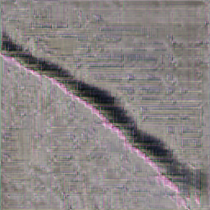
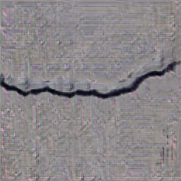
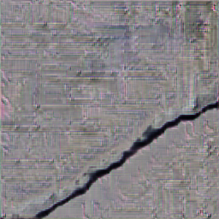
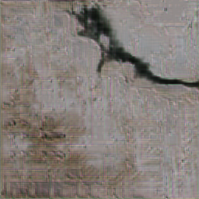
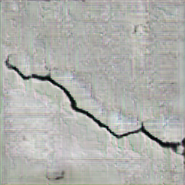
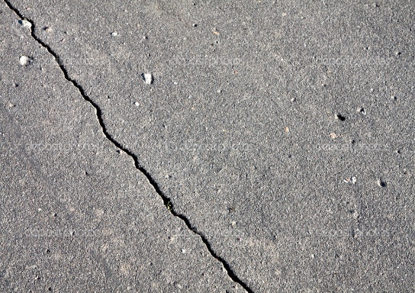
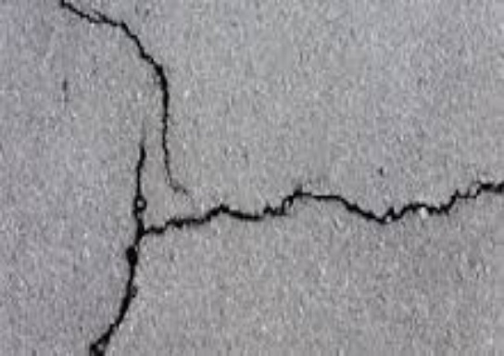
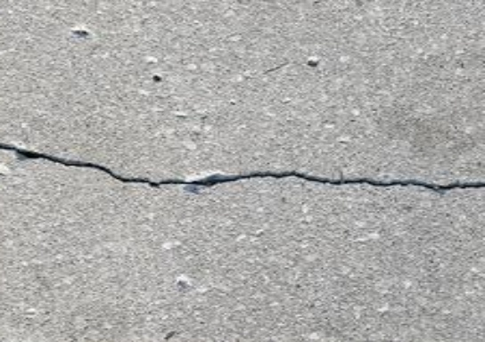
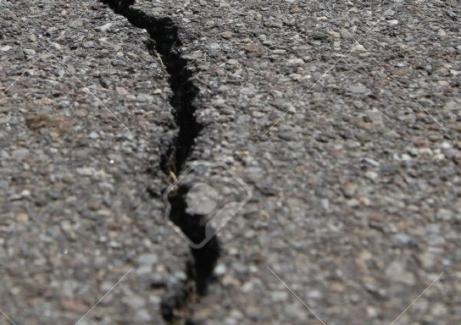
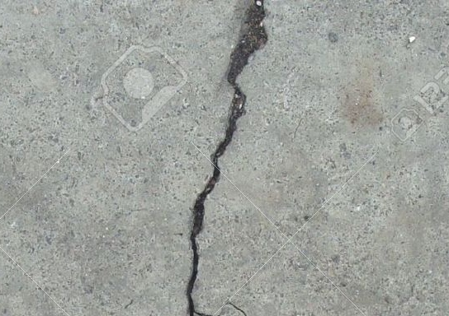
















Random input vector (4096)
Conv2DTranspose (4$×$4)
GaussianNoise (0.2)
ReLU
Fake images
Conv2D (3$×3$)
G-Block
G-Block(4$×$4)
LeakyReLU (0.2)
Conv2D (4$×$4)
G-Block(4$×$4)
Dropout (0.25)
BatchNormalization (0.7)
G-Block(3$×3$)
AveragePooling2D
ReLU
G-Block(3$×3$)
D-Block(3$×3$)
UpSampling2D
G-Block(3$×3$)
D-Block(3$×3$)
Conv2D(3$×3$)
D-Block(3$×3$)
D-Block
ReLU
D-Block(3$×3$)
Conv2D (3$×3$)
UpSampling2D
D-Block(3$×3$)
BatchNormalization (0.7)
Conv2D (3$×3$)
Flatten
LeakyReLU (0.2)
Sigmoid
Dense(128)
Dropout (0.25)
Real images
LeakyReLU (0.2)
AveragePooling2D
Dense(1)
Real/fake
Update model
Update model

Slide 6





decoder2D
Conv2D (3$×3$)
BatchNorm2D
ReLU
self.decoder_1 = nn.Sequential(
nn.Conv2d(in_channels, features[0], 3, padding=1),
nn.BatchNorm2d(features[0]),
nn.ReLU(inplace=True),
nn.Upsample(scale_factor=2, mode="bilinear", align_corners=True)
)
self.decoder_2 = nn.Sequential(
nn.Conv2d(features[0], features[1], 3, padding=1),
nn.BatchNorm2d(features[1]),
nn.ReLU(inplace=True),
nn.Upsample(scale_factor=2, mode="bilinear", align_corners=True)
)
self.decoder_3 = nn.Sequential(
nn.Conv2d(features[1], features[2], 3, padding=1),
nn.BatchNorm2d(features[2]),
nn.ReLU(inplace=True),
nn.Upsample(scale_factor=2, mode="bilinear", align_corners=True)
)
self.decoder_4 = nn.Sequential(
nn.Conv2d(features[2], features[3], 3, padding=1),
nn.BatchNorm2d(features[3]),
nn.ReLU(inplace=True),
nn.Upsample(scale_factor=2, mode="bilinear", align_corners=True)
)
self.final_out = nn.Conv2d(features[-1], out_channels, 3, padding=1)
Upsampling
Conv2D (3$×3$)
BatchNorm2D
ReLU
Upsampling
Conv2D (3$×3$)
BatchNorm2D
ReLU
Upsampling
Conv2D (3$×3$)
BatchNorm2D
ReLU
Upsampling
Conv2D (3$×3$)

Slide 7




decoder2D
Conv2D (3$×3$)
BatchNorm2D
ReLU
UpSample
Conv2D (3$×3$)
BatchNorm2D
ReLU
UpSample
Conv2D (3$×3$)
BatchNorm2D
LeakyReLU
UpSample
Conv2D (3$×3$)
BatchNorm2D
LeakyReLU
UpSample
LeakyReLU

Slide 8
Linear
Eecoder2D
InputDense2D
ACT2FN
rearrange
TranslayerNorm
TransModel2d
Embedding
Final dense
TransEmbeddings
TranslayerNorm
rearrange
droupout
transselfattention
transselfoutput
Transattention
TransEncoder
Linear
Translayer
transintermediate
ACT2FN
Transoutput
Linear
droupout
TranslayerNorm

Slide 9



Linear
Input
GELU
TranslayerNorm
Linear
Linear
Linear
Embedding
TranslayerNorm
$$×$$
Drop out
Attention
SoftMax
Drop out
Linear
Drop out
$$×$$
TranslayerNorm
Linear
Output
GELU
Linear
$$×$$
: Matrix multiple
Drop out
TranslayerNorm

Slide 10






Conv2D (3$×3$)
BatchNorm2D
RELU
Linear
UpSample
GELU
Conv2D (3$×3$)
TranslayerNorm
BatchNorm2D
Embedding
RELU
TranslayerNorm
UpSample
Drop out
Conv2D (3$×3$)
Attention
BatchNorm2D
LeakyReLU
Linear
UpSample
Drop out
Conv2D (3$×3$)
TranslayerNorm
BatchNorm2D
Linear
LeakyReLU
GELU
UpSample
Linear
LeakyReLU
Drop out
TranslayerNorm
Encoder
Decoder

Slide 11






IRI
Linear
Multi-head Attention
$$y_{0}$$
$$y_{1}$$
$$y_{n}$$
$$y_{0}$$
$$y_{1}$$
$$y_{n}$$
…
…
…
…
$$x_{0}$$
$$x_{1}$$
$$x_{n}$$
$$x_{0}$$
$$x_{1}$$
$$x_{n}$$

Slide 12





























(a)
(b)
$$y_{i}$$
IRI
$$c_{i−1}$$
$$×$$
$$+$$
$$c_{i}$$
Linear
$$×$$
$$t$$
Multi-head Attention
$$σ$$
$$σ$$
$$×$$
$$t$$
$$h_{i−1}$$
$$σ$$
$$h_{i}$$
$$y_{0}$$
$$y_{1}$$
$$y_{n}$$
$$y_{0}$$
$$y_{1}$$
$$y_{n}$$
$$x_{i}$$
…
…
…
…
$$×$$
: multiplication
$$t$$
: tanh
$$x_{0}$$
$$x_{1}$$
$$x_{n−1}$$
$$x_{0}$$
$$x_{1}$$
$$x_{n}$$
: sum over inputs
$$σ$$
: sigmoid
$$+$$

Slide 13























(a)
$$y_{i}$$
(b)
IRI
$$c_{i−1}$$
$$×$$
$$+$$
$$c_{i}$$
Linear
$$×$$
$$t$$
$$σ$$
$$σ$$
$$×$$
Multi-head Attention
$$t$$
$$h_{i−1}$$
$$σ$$
$$h_{i}$$
$$y_{0}$$
$$y_{1}$$
$$y_{n−1}$$
$$y_{0}$$
$$y_{1}$$
$$y_{n−1}$$
$$x_{i}$$
…
…
…
…
Forget gate
$$×$$
Multiplication
$$t$$
Tanh
Input gate
$$+$$
Sum over inputs
$$σ$$
Sigmoid
$$x_{0}$$
$$x_{1}$$
$$x_{n−1}$$
$$x_{0}$$
$$x_{1}$$
$$x_{n−1}$$
Output gate
Candidate memory

Slide 14





















(a)
(b)
$$y_{i}$$
IRI
$$c_{i−1}$$
$$×$$
$$+$$
$$c_{i}$$
Fully-connected Layer
…
…
$$×$$
$$t$$
$$σ$$
$$σ$$
$$×$$
Multi-head Attention
$$t$$
$$h_{i−1}$$
$$σ$$
$$h_{i}$$
…
…
$$y_{0}^{e}$$
$$y_{1}^{e}$$
…
$$y_{n−1}^{e}$$
$$y_{0}^{d}$$
$$y_{1}^{d}$$
…
$$y_{n−1}^{d}$$
$$x_{i}$$
…
…
…
…
Forget gate
Multiplication
$$t$$
Tanh
$$×$$
Input gate
$$+$$
Sum over inputs
$$σ$$
Sigmoid
$$x_{0}$$
$$x_{1}$$
$$x_{n−1}$$
$$x_{0}$$
$$x_{1}$$
$$x_{n−1}$$
Output gate
Encoder
Decoder
Candidate memory

Slide 15
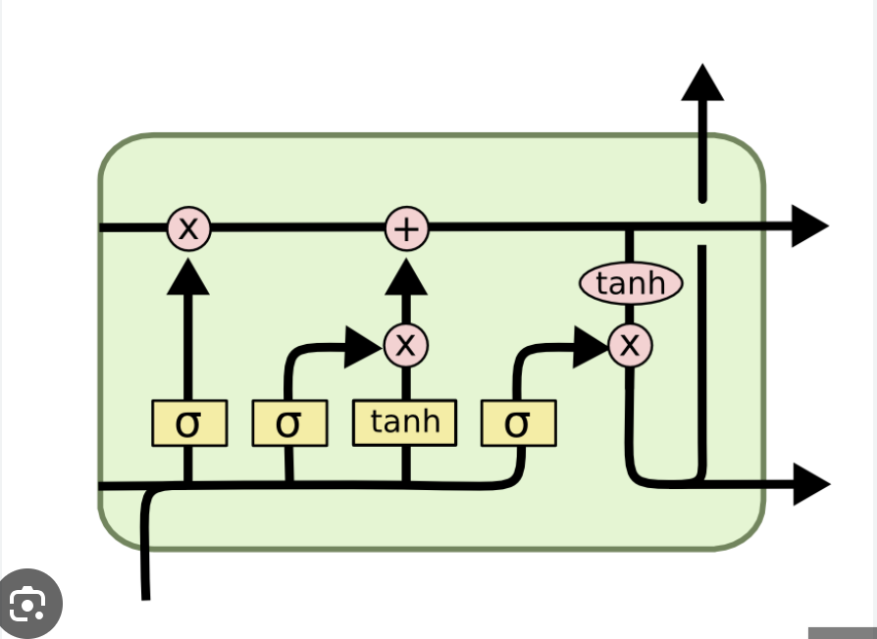

















$$y_{i}$$
$$c_{i−1}$$
$$c_{i}$$
$$×$$
$$+$$
$$×$$
$$t$$
$$x_{1}$$
$$σ$$
$$σ$$
$$×$$
$$tanh$$
$$t$$
$$σ$$
$$h_{i−1}$$
$$h_{i}$$
$$x_{i}$$
$$σ$$

Slide 16












































(a)
$$IRI$$
…
…
(b)
…
$$N>n$$
$$X_{0}$$
$$X_{i}$$
$$X_{N}$$
$$0$$
0
$$X_{0}$$
$$X_{1}$$
$$AADT$$
$$0$$
…
$$X_{0}$$
$$X_{1}$$
$$X_{2}$$
$$Age$$
Sequences (length = n)
…
$$X_{N−n}$$
$$X_{N−n+1}$$
…
$$X_{N−1}$$
$$X_{N}$$
$$H_{ave}$$
(c)
$$N=n$$
(d)
$$N<n$$
$$0$$
0
…
$$X_{0}$$
$$X_{1}$$
…
$$0$$
0
$$X_{0}$$
$$X_{1}$$
$$0$$
…
$$X_{0}$$
$$X_{1}$$
$$X_{2}$$
…
$$0$$
$$X_{0}$$
$$X_{1}$$
$$X_{2}$$
…
…
$$X_{0}$$
$$X_{1}$$
…
$$X_{N−1}$$
$$X_{N}$$
$$0$$
…
$$X_{0}$$
$$X_{1}$$
…
$$X_{N−1}$$
$$X_{N}$$

Slide 17
















$$IRI$$
$$X_{0}$$
…
$$X_{i}$$
…
$$X_{N}$$
$$AADT$$
$$Age$$
$$0$$
0
…
$$X_{0}$$
$$X_{1}$$
$$H_{ave}$$
$$0$$
…
$$X_{0}$$
$$X_{1}$$
$$X_{2}$$
Sequences (length = n)
…
$$X_{N−n}$$
$$X_{N−n+1}$$
…
$$X_{N−1}$$
$$X_{N}$$

Slide 18



















$$X_{0}$$
Sequences (length = n)
$$X_{1}$$
$$IRI$$
$$0$$
0
…
$$X_{0}$$
$$X_{1}$$
…
$$AADT$$
$$0$$
…
$$X_{0}$$
$$X_{1}$$
$$X_{2}$$
$$X_{i}$$
…
$$Age$$
$$X_{N−n}$$
$$X_{N−n+1}$$
…
$$X_{N−1}$$
$$X_{N}$$
$$H_{ave}$$
…
$$X_{N}$$

Slide 19












Sequences (length = n)
$$X_{0}$$
$$X_{1}$$
$$0$$
0
…
$$X_{0}$$
$$X_{1}$$
$$IRI$$
…
…
$$0$$
$$X_{0}$$
$$X_{1}$$
$$X_{2}$$
$$AADT$$
$$X_{i}$$
…
$$Age$$
$$H_{ave}$$
…
…
$$X_{N−n−1}$$
$$X_{N−n}$$
$$X_{N−2}$$
$$X_{N−1}$$
$$X_{N−1}$$

